Slide 1
Texas Holdem poker AI Utilizing machine learning techniques
By Isaac Lewis

Slide 2
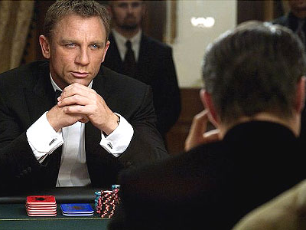
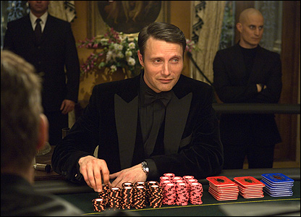
The Objective
Predicting what an opponent will do next
Does the villain really have strong cards - or are they bluffing?
Opponent Modeling: guessing what cards an opponent has, and predicting their next move
The problem: noise, high dimensionality, tricky opponents
The solution: Machine Learning?

Slide 3
CONTENTS
How to play Poker
Poker Server & Web Frontend: Implementation and Demo
The 3 types of Poker AI
The Miximax algorithm
TeaBot, our basic pokerbot
TeaBot: Demo and Results
CoffeeBot, our improved pokerbot
CoffeeBot: Demo and Results

Slide 4
Rules of Poker
Objective: Make the best set of cards possible
Each player has 2 personal cards (“hole cards”) . These are kept hidden
Over the course of a hand, 5 cards are dealt to the board
Choose the best 5-card subset of the 7 cards available
If you have the best cards, you win!
Betting makes things more complicated
Three choices: check, raise, fold
Good chance of winning: raise and increase the bet!
OK chance of winning: check/call and keep bet the same size
Poor chance of winning: cut your losses and fold
If you fold, your opponent wins - make sure you don’t get bluffed
… or slowplayed

Slide 5
POKER SERVER
Allows two players (who may be humans or computer programs) to play a game of poker
Implements the rules of poker and handles shuffling, dealing, betting etc
Written in Ruby
Communicates with the client programs (players) via TCP
About ???? lines of code
PokerServer
Player
Game
ChipStore
Deck
RankedHand
Card
Rank

Slide 6
Web FRONTEND
Provides a human-friendly interface
Implemented as a client of the poker server
WebClient
  One thread controls the web server
  One thread controls the poker client
  Sends updates from the PokerServer to the browser via AJAX
  Routes user input to the PokerServer
Browser
HTTP
WebClient
PokerServer
TCP

Slide 7
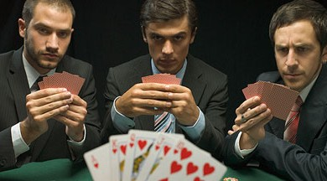
Three types of POKER AI
Rules-based bots follow a predefined rule for each situation
  Pro: easy to create
  Con: too simplistic
Equilibrium bots try to find a Nash Equilibrium (a “safe” strategy)
  Pro: don’t lose much
  Con: don’t (always) win much
Exploitative bots try and find their opponents’ weaknesses
  Pro: can win a lot
  Con: can lose a lot

Slide 8
Minimax and miximax
Miximax: generalization of minimax. Assume the opponent follows a mixed strategy; that is, each action is taken with some probability
Player nodes are the same as minimax
EV of opponent nodes equal to sum of EV of child nodes, weighted by estimated probability of opponent taking that action
EV of leaf nodes weighted by estimated chance of winning at that node
The exploitative algorithm used in our project
In minimax, EV is computed recursively on the game tree
Player nodes: EV is equal to max EV of children
Opponent nodes: EV is equal to min EV of children
EV of leaf nodes predefined
max(-2, 3) = 3
max(4,4, 1.8) = 4.4
min(-2,8) = -2
min(3, 7) = 3
.2 * 6 + .8 * 4 = 4.4
.9 * 1 + .1 * 9 = 1.8
-2
8
3
7
.6 *10 = 6
.5 * 8 = 4
.2 * 5 = 1
.9 * 10 = 9

Slide 9
MIXIMAX
Miximax (and a more general algorithm, miximix) were introduced in the paper “Game Tree Search with Adaptation in Stochastic Imperfect Information Games”
Describes the implementation of Vexbot, a pokerbot that implements miximax
Two main issues with implementing miximix/miximax:
  Estimating probabilities of opponent actions (opponent modelling)
  Estimating win probabilities at leaf nodes
Vexbot used histograms to solve these problems. Can we do better?

Slide 10
OUR approach
Treat opponent modeling as a supervised learning problem
Given a game situation, predict if the opponent will check, raise or fold – ie, classify that situation as a check, raise or fold
Use observations of past games against an opponent as training data (means our bot is weak initially)
We can then pass a new situation to our classifier, and then use the outputted probability distribution as an estimate of the opponent action probabilities
E.g. 41% chance situation is classified as “fold” = 41% chance opponent will fold

Slide 11
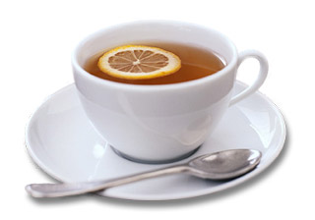
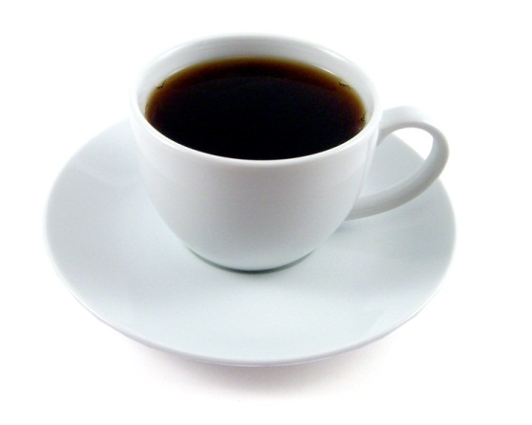
TEABOT AND COFFEEBOT
TeaBot: proof of concept of miximax
CoffeeBot: improve TeaBot using supervised learning

Slide 12
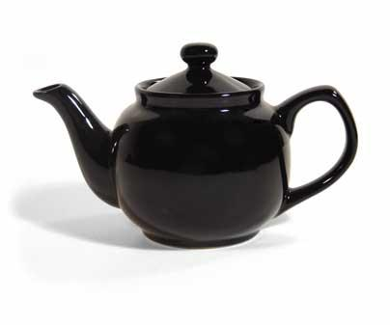
TEaBOT
Stands for “Terrific Exploitative Algorithmic Bot”
Implements a “proof of concept” of the miximax algorithm
Opponent modeling: assumes opponent’s actions are randomly distributed (very simplistic!)
E.g., if we have seen the opponent raise 3 times, call 2 times and fold once, assume opponent always raises with probability 3/6 ,calls with probability 2/6, and folds with probability 1/6
Win estimation uses similar method to Vexbot

Slide 13
implementation
Client
Player
Written in Java (about ??? LoC)
OpponentModel implemented as an interface, with two implementations
TeaBot uses BasicOpponentModel
CoffeeBot uses ImprovedOpponentModel
GameState
OpponentModel
GameInfo
BasicOM
ActionList
ImprovedOM
CardArray

Slide 14
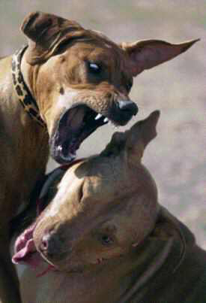
Testing
How does TeaBot perform against an opponent?
We wrote three bots to test against
AlwaysCheck and AlwaysRaise always perform the same action
RulesBot follows a rules-based strategy that considers the current betting round and the strength of its cards (and easily defeats AlwaysCheck and AlwaysRaise!)
We tested with 2 matches of 10,000 hands each
Cards were reversed between the two hands to reduce variance

Slide 15
Testing
TeaBot vs AlwaysCheck
(wins easily and consistently)
TeaBot vs AlwaysRaise
(wins more, but less consistent – AlwaysRaise is more “intimidating”)

Slide 16
TEABOT vs RULESBOT
TeaBot loses!
What happened? It seems our clever exploitative bot has been defeated by a simple rules-based bot!
TeaBot’s opponent modeling strategy is unrealistic and ineffective against RulesBot
Can we do better?

Slide 17
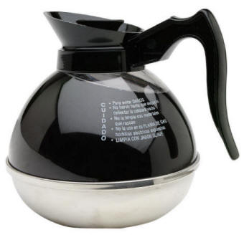
COFFEBOT
Uses machine learning for opponent modeling
ML classifiers provided by Weka machine learning library
We experimented with two ML algorithms: Naïve Bayes classifiers and Neural Networks
Chose these two as they are dissimilar; e.g. Naïve Bayes assumes features are independent, Neural Networks do not
The question: is CoffeeBot stronger than TeaBot?

Slide 18
COFFEEBot vs Alwayscheck
CoffeeBot w/ Naïve Bayes
CoffeeBot w/ Neural Networks
(performance is very similar for both ML classifiers, and about the same as TeaBot)

Slide 19
COFFEEBot vs Alwaysraise
CoffeeBot w/ Naïve Bayes
(Average performance is stronger than TeaBot, but less consistent between the two matches)
CoffeeBot w/ Neural Networks
(shows the same pattern of inconsistency as Naïve Bayes)

Slide 20
COFFEEBot vs rulesbot
CoffeeBot w/ Naïve Bayes
(unlike TeaBot, defeats RulesBot! But very inconsistent between the two matches)
CoffeeBot w/ Neural Networks
(overall performance better than Naïve Bayes, but more inconsistent – loses the first match)

Slide 21
evaluation
Is miximax effective?
  Yes, but not without a decent opponent modelling function, as RulesBot’s defeat of TeaBot demonstrates
  RulesBot also did better against AlwaysRaise; maybe because TeaBot and CoffeeBot were more “intimidated” by AlwaysRaise’s aggressive play

Slide 22
evaluation
Was our approach to opponent modeling effective?
  Yes, as CoffeeBot generally outperformed TeaBot
  Though TeaBot did better against AlwaysRaise
  TeaBot’s performance was also more consistent

Slide 23
evaluation
Why was CoffeeBot’s performance so inconsistent between matches?
  This may be due to the different cards received during between the two matches
  During the first match, RulesBot begins with some strong cards, so CoffeeBot learns that RulesBot “always” has strong cards and plays aggressively

Slide 24
evaluation
Which classifier performed better: Naïve Bayes or Neural Networks?
  Neural Networks were slightly better on average (perhaps because Naïve Bayes makes the naïve assumption of independence)
  Though Neural Networks also more inconsistent

Slide 25
Summary
Wrote a pokerbot (TeaBot) based on miximax algorithm
Improved miximax using machine learning for opponent modeling (CoffeeBot)
Also wrote a poker server and several opponents to test against
Our approach led to improved performance, though with some inconsistency
Neural networks worked slightly better than naïve Bayes classifiers
ANY QUESTIONS?

